Slide 1
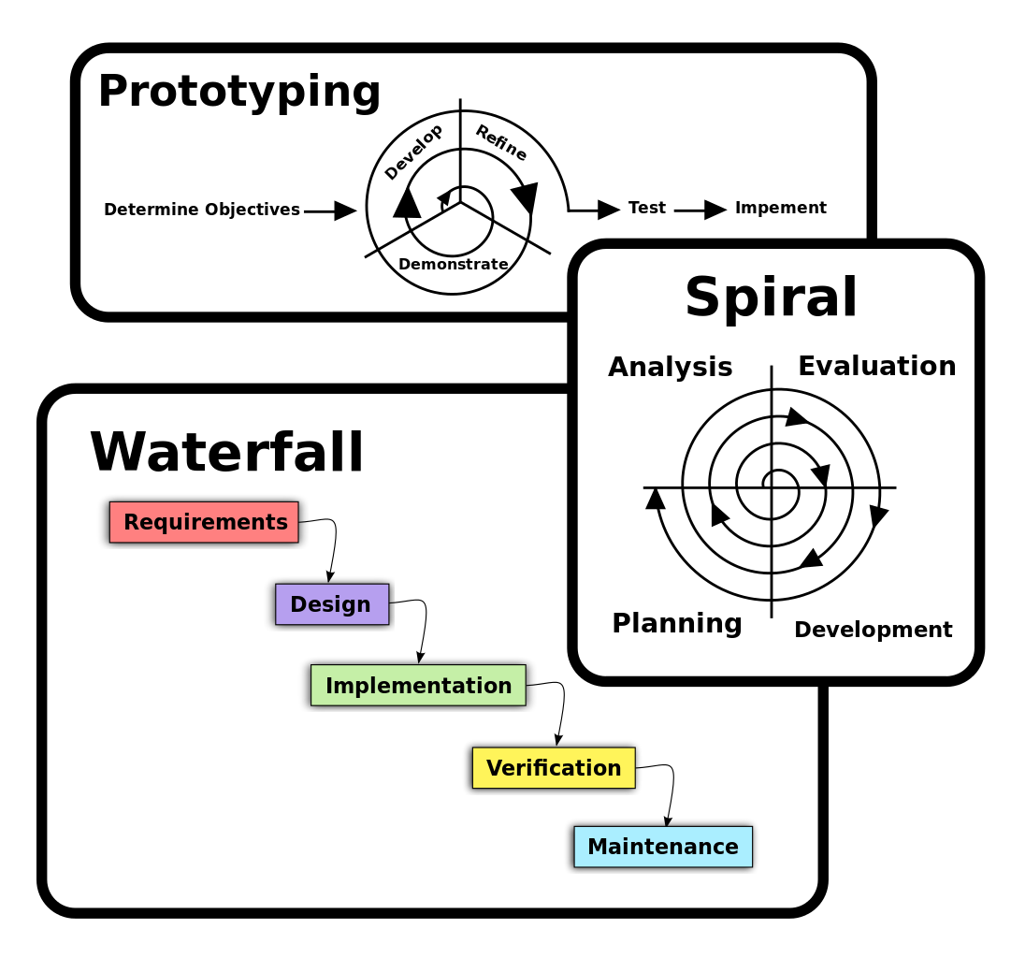
Software Process

Slide 2
Software Process
Series of predictable steps-a road map that helps create a timely and high quality entity
Process
Software Process is a framework for the tasks that are required to build high quality software

Slide 3
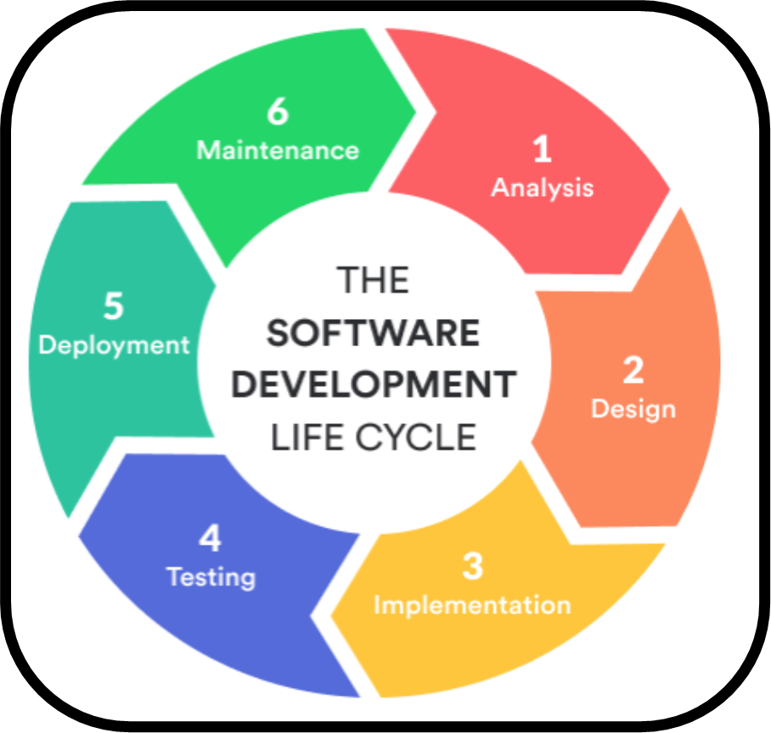
Software Development Life Cycle (SDLC)

Slide 4
SDLC: Structured Analysis
Data Modeling
  Entity Relation Diagram (ERD)
  Data Dictionary (DD)
Functional Modeling
  Data Flow Diagram (DFD)
  Process Specification (PS) and Mini Specification (MS)
Behavioral Modeling
  State Transition Diagram
  Control Specification (CS)

Slide 5
SDLC: Structured Design
Data Design
Architectural Design
Component Level Design
User Interface Design

Slide 6
Software Engineering: A Layered Technology
Tools
Methods
Process
A Quality Focus

Slide 7
Software Engineering: A Generic View
Phases of Work
Associated With
Software Engineering
Definition Phase
Development Phase
Support Phase
Correction
Adaptation
Enhancement
Prevention

Slide 8
Software Engineering: A Generic View
Measurement
Phases of Work
Associated With
Software Engineering
Risk Management
Reusability management
Definition Phase
Development Phase
Support Phase
Correction
Document preparation & production
Software project tracking control
Adaptation
Enhancement
Prevention
Software configuration management
Formal technical reviews
Software quality assurance

Slide 9
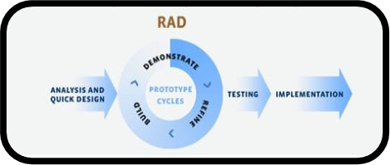

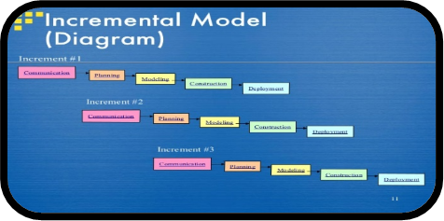
Software Process Models
Linear Sequential Model (LSM)
Prototyping Model
Rapid Application Development Model (RAD)
Incremental Model
Spiral Model

Slide 10
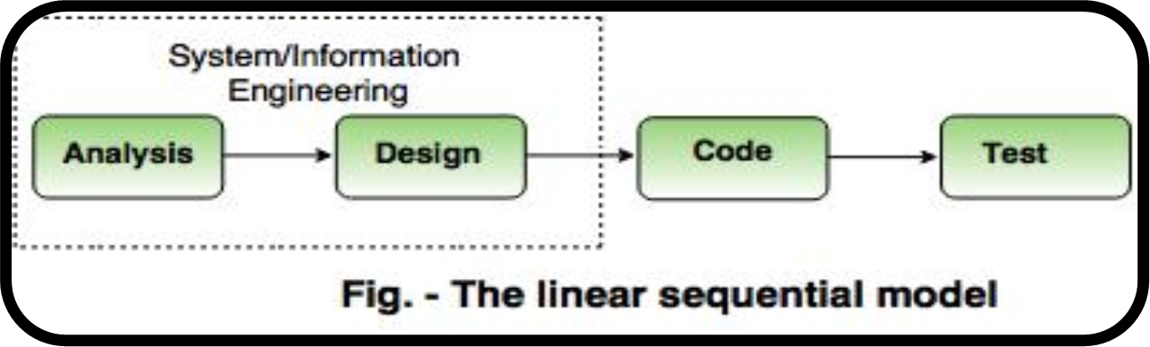
Linear Sequential model
Also known as the classic life cycle or waterfall
model, it suggests a systematic, sequential approach
to software development that begins at the system
level and progress through analysis, design, coding, testing and support.

Slide 11
Linear Sequential model
System / Information Engineering
Analysis
Design
Code
Test

Slide 12
Linear Sequential model
Limitations
Real projects rarely follow the sequential flow and changes can cause confusion.
This model has difficulty accommodating requirements change.
The customer will not see a working version until the project is nearly complete.
Developers are often blocked unnecessarily, due to previous tasks not being done.

Slide 13
Prototyping Model:
The developer and customer define the overall objectives for the software. A quick design focuses on what the customer will see. From this, a prototype is constructed. The user evaluates it and improvements are made. This continues in an iterative fashion until a satisfactory product is achieved.

Slide 14
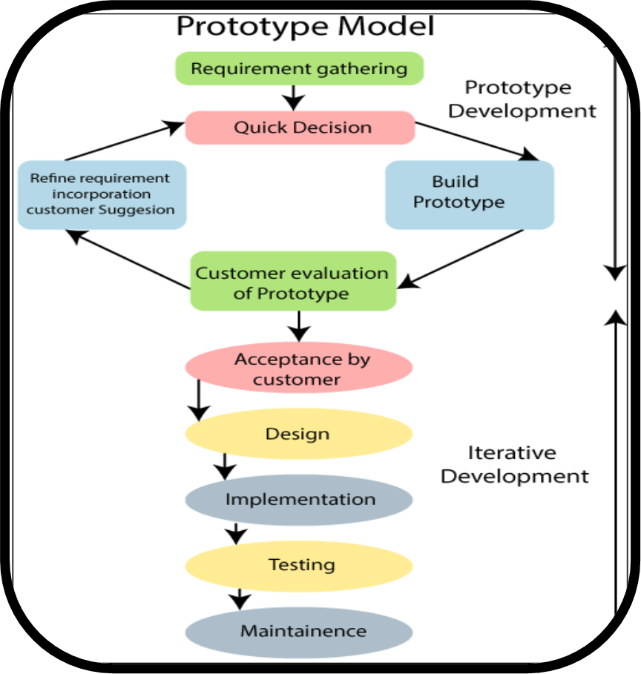
Prototyping:

Slide 15
Problems with prototyping:
The customer sees a working version and expects the finished product to be available in a short time. This puts pressure on the developer to take short cuts, at the expense of quality and maintainability.
The developer may make compromises for speed.
Inappropriate tools may be used or inefficient algorithms may be used, which then become integral parts of the system.
If the user isn’t focused on what they want, the system may never be completed.

Slide 16
Rapid Application Development Model (RAD):
Rapid Application Development is a linear sequential software development process model that emphasises an extremely short development cycle.
A component-based construction approach is used.
To use this approach, the project scope must be constrained and the requirements should be well understood.
A task that should take no more than ninety days to complete is modelled, generated and implemented.
There can be several teams working on different components during this ninety day time-box.

Slide 17
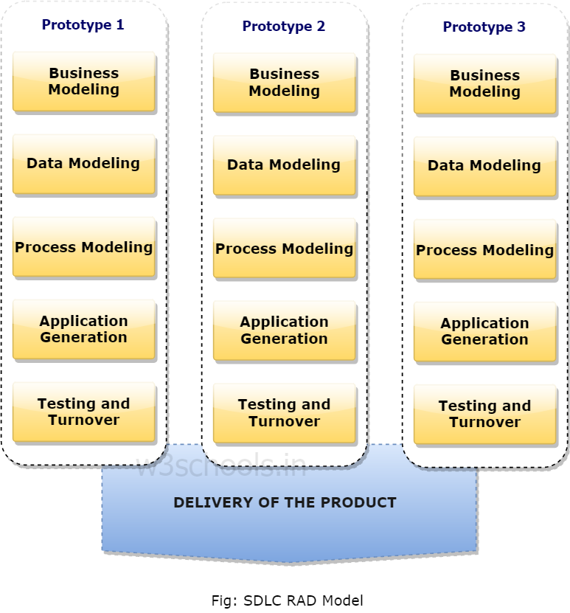
The RAD model

Slide 18
Problems with RAD:
For large, scalable projects, RAD requires sufficient human resources to create the right number of RAD teams
RAD requires developers and customers who are committed to the rapid-fire activities necessary to complete a system in this time frame, or failure will result.

Slide 19
The incremental model
This is a combination of the linear sequential model and the iterative model.
The problem is broken into increments, and each increment is tackled as a linear sequence.
Further increments can either be done after the previous ones, or can overlap with the previous ones.
Incremental delivery focuses on the delivery of an operational product with each increment.
Early increments are stripped-down versions of the final product.

Slide 20
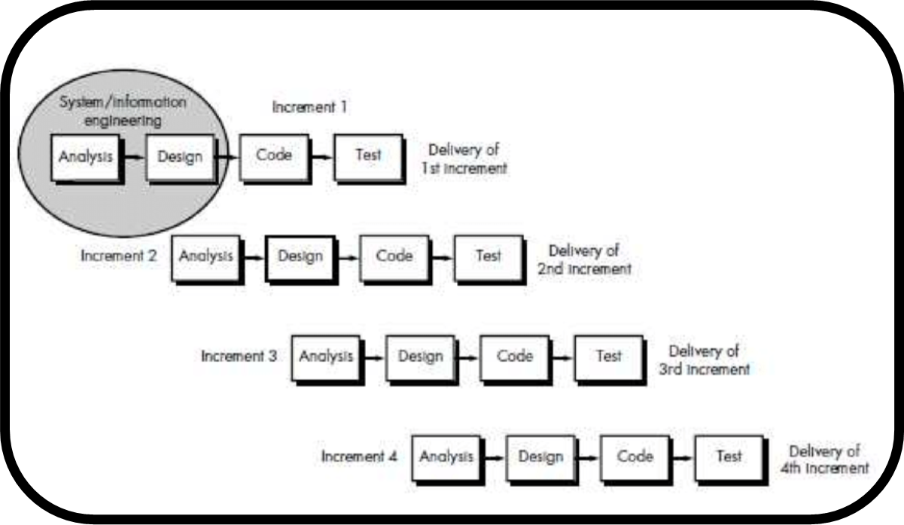
Incremental model:

Slide 21
Evolution of MS Windows:
Sr. # | MS Windows Version | Year | Features: Added or changed
1 | Windows 1 | 1985
2 | Windows 2 | 1987
3 | Windows 3 | 1990
4 | Windows 3.1 | 1992
5 | Windows 95 | 1995
6 | Windows 98 | 1998
7 | Windows Me | 2000
8 | Windows 2000 | 2000
9 | Windows XP | 2001
10 | Windows Vista | 2007
11 | Windows 7 | 2009
12 | Windows 8 | 2012
13 | Windows 8.1 | 2013
14 | Windows 10 | 2014

Slide 22
Advantages of Incremental model:
  Less staffing is required than in a RAD project
  Early delivery is guaranteed
  Progress of the whole project is not delayed if one of the resources is not available for part of it

Slide 23
The Spiral model:
Boehm’s (1988) spiral model couples the iterative nature of prototyping with the controlled and systematic aspects of the linear sequential model.
Software is developed in a series of incremental releases.
During the early releases, there may be just a paper model, but the system becomes increasingly more complete.
There are a number of framework activities (Customer communication, Planning, Risk analysis, Engineering, Construction and release, Customer evaluation).
Unlike any of the other models, this model keeps revisiting the system throughout its lifetime.

Slide 24
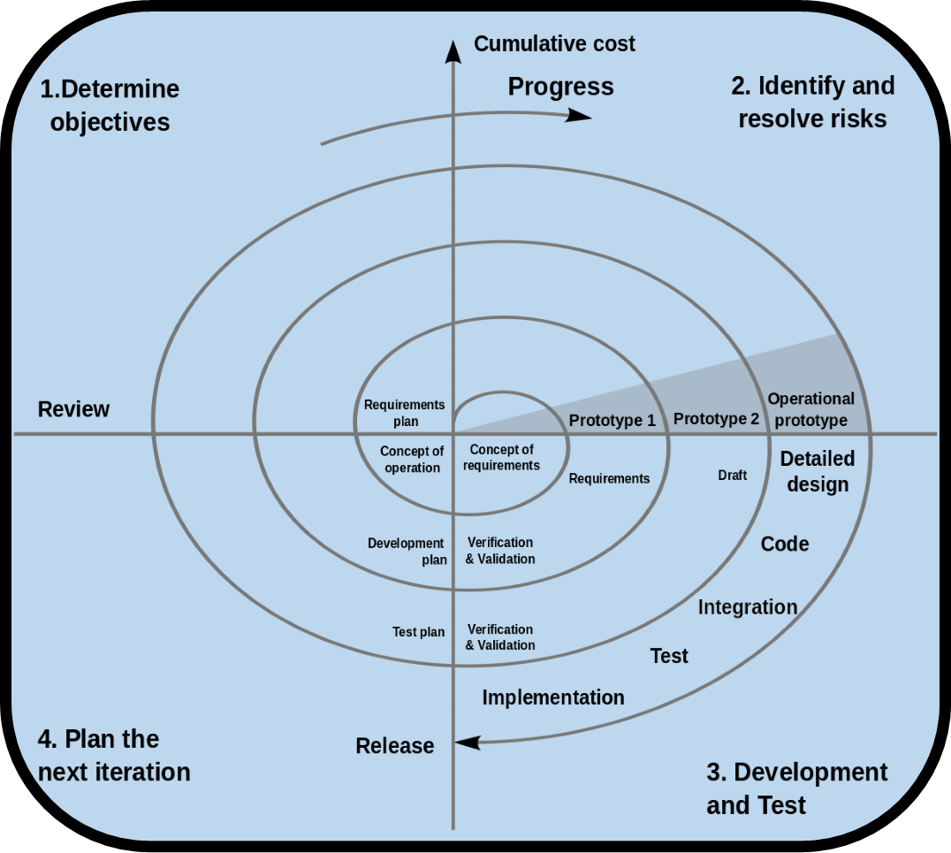

Slide 25
Concluding Remarks:
There are a variety of process models, each of which can be used successfully.
Once a process model has been used to develop a system, documentation style, organisation and structure should either remain in the format of that process model, or all be converted to a different process model.
This is particularly important where automated tools are used.

Slide 26
Thank You!

